Slide 1
Team : Winnipeg Defense Group
Snow Sense Winnipeg

Slide 2
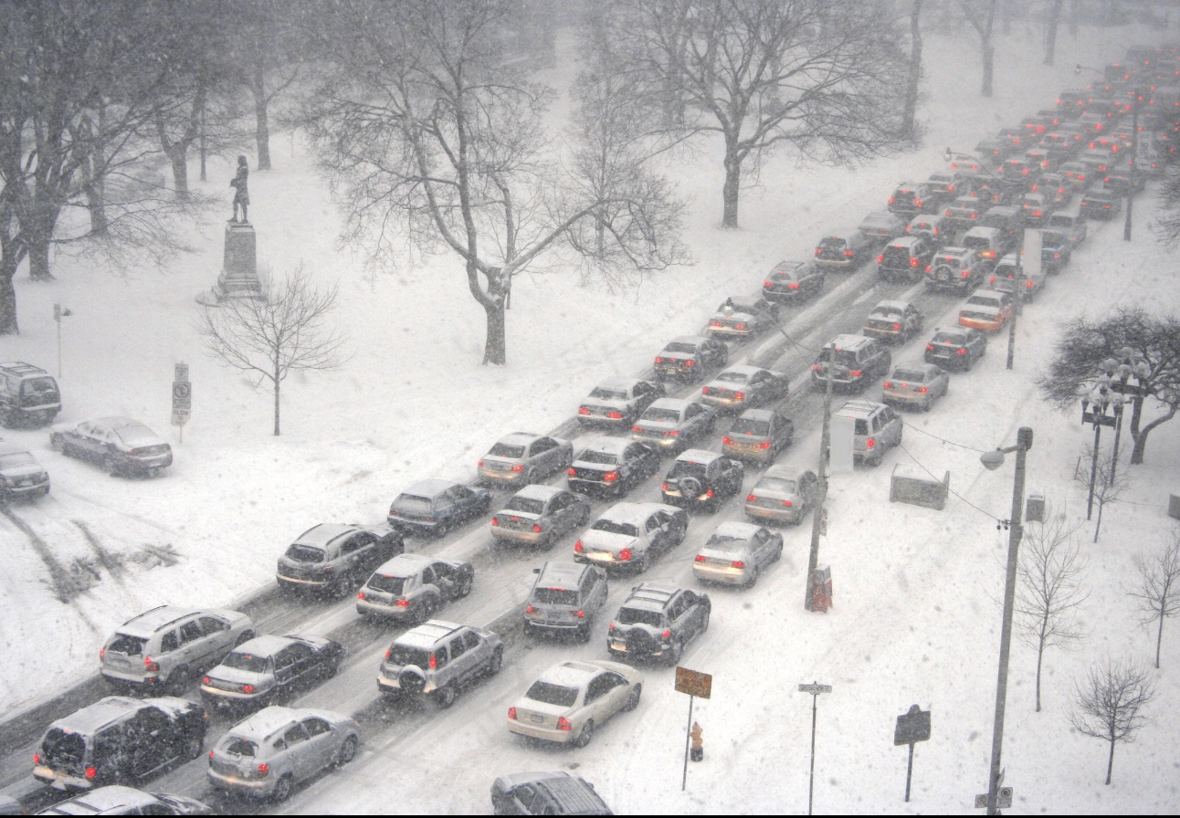
Problem Statement :

Slide 3
Drivers are generally unaware of
Which roads are cleared
Which routes to avoid
Risky routes
Routes undergoing plowing
This results in traffic accidents , delays and emergency delays.

Slide 4
Data we are using
Plow Zone Schedule
Snow Parking Bans
Snow Clearing Status
Road Network Map
From the Winnipeg Open Data Portal

Slide 5
What we built
An app that->
Predicts snow congestion risk
Shows real-time plow zones
Recommend best winter routes
Show parking ban alerts
Structure:
User enters destination
↓
AI analyzes
• snow clearing data
• plow schedule
• road network
↓
System recommends safest route

Slide 6
How it works
Screenshot of website goes here

Slide 7
Benefits
By enabling residents to get the best cleared routes and real-time parking guidance, we->
reduce congestion
prevent parking violations
Improve winter mobility in Winnipeg

